Slide 1
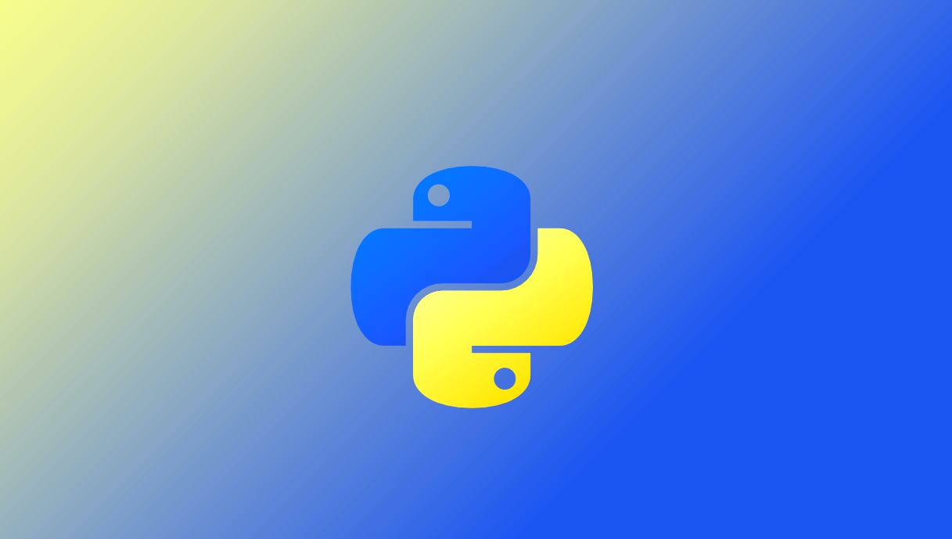
Data Analysis with Python
© Jason Zhang. All Rights Reserved.

Slide 2

COURSE AGENDA
Introduction
to Python
Python
Basics
Data Structure
Pandas/Numpy
Guidebook
Functional Programming
Exception Handling
Files
In/Out
Data Wrangling with Pandas & Numpy
Efficient code
Error Handling
Work with Files
Python intro
Fundamentals
Data Type
Control Flow
Functions
Data structures
Python
Fundamentals
Data structures
Pandas / Numpy:
Functional programming
Error handling
File Operations
What is Python
Why Tableau
Environment Setup
Jupyter notebooks
Data types
Control flows, such as if else, for loop, while break etc.
Operators
Build own function
List
Tuple
Dictionary
Set
Methods to work with different data structures
Pandas operations
Merge/concat data
In/Out files in Pandas
Numpy operations
Functions & Methods in Numpy
Functions to make data processing convenient
List comprehension
Errors in programming
Debug
Exception handling in Python
Read files
Write files
Work with JSON files
Goals
Master Python basics to build efficient programs
Learn to use Pandas and Numpy to analyze data sets
Learn to process files and handle errors to automate daily routine works
© Jason Zhang. All Rights Reserved.

Slide 3

1.1 Intro to Python
What is python?
Python is an interpreted, high-level and general-purpose programming language. Python's design philosophy emphasizes code readability with its notable use of significant indentation.
What can python do?
Software and web application development
Data processing, scientific computing
Machine learning, artificial intelligence
System scripting, robotic processing
…
Why python?
Python is easy to use, powerful, and versatile, making it a great choice for beginners and experts alike. Python's readability makes it a great first programming language.
© Jason Zhang. All Rights Reserved.
Notes:
Python can be used to build server-side web applications, whereby creating, deploying and operating web applications and application programming interfaces for the Web is more efficient with the use of existing open-source libraries to speed up the process of a working application.

Slide 4
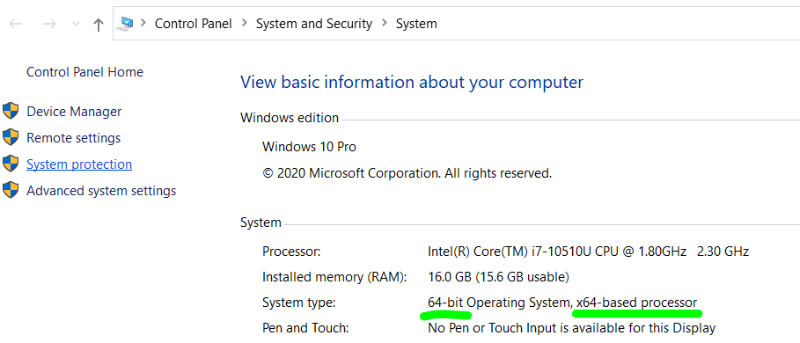
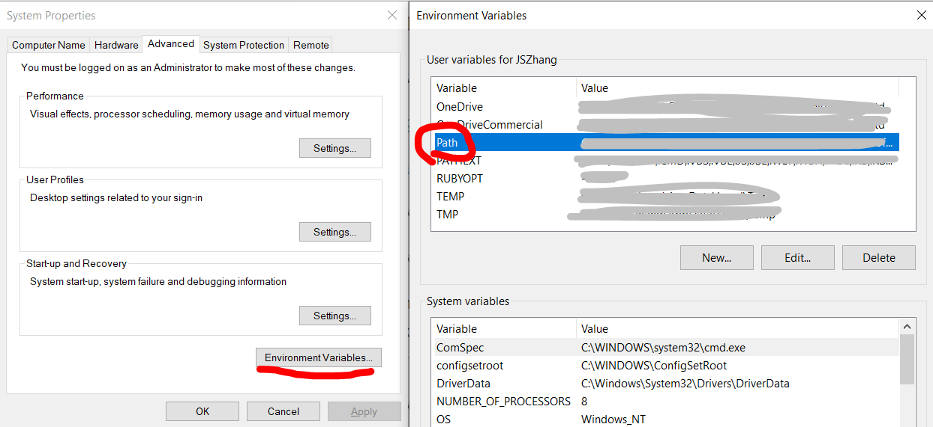
1.2 Install Python on Windows
Windows
Download Python installer from website (https://www.python.org/downloads/windows/ ) based on your Windows version (32-bit or 64-bit).
Run the downloaded installer program, remember to select Add Python 3.x to PATH before clicking Install Now
To run Python3 REPL (interactive program, REPL stands for Read-Evaluate-Print-Loop), type python in Command Prompt.
Windows
If you see error message 'python' is not recognized as an internal or external command,
then add the path to python.exe to environment variables
© Jason Zhang. All Rights Reserved.

Slide 5
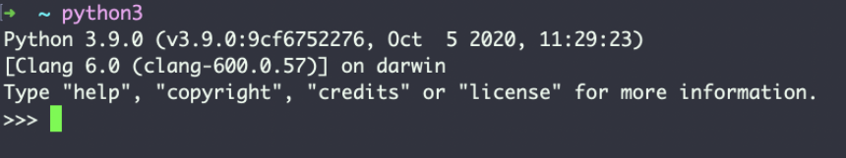
1.2 Install Python on MacOS
Method 1:
Download Python installer from website (https://www.python.org/downloads/mac-osx/ ).
Method 2:
Run command brew install python3 if Homebrew is installed
To run Python3 REPL, type python3 in Terminal application.
© Jason Zhang. All Rights Reserved.
Notes:
https://docs.python-guide.org/starting/install3/osx/
https://flaviocopes.com/python-installation-macos/

Slide 6
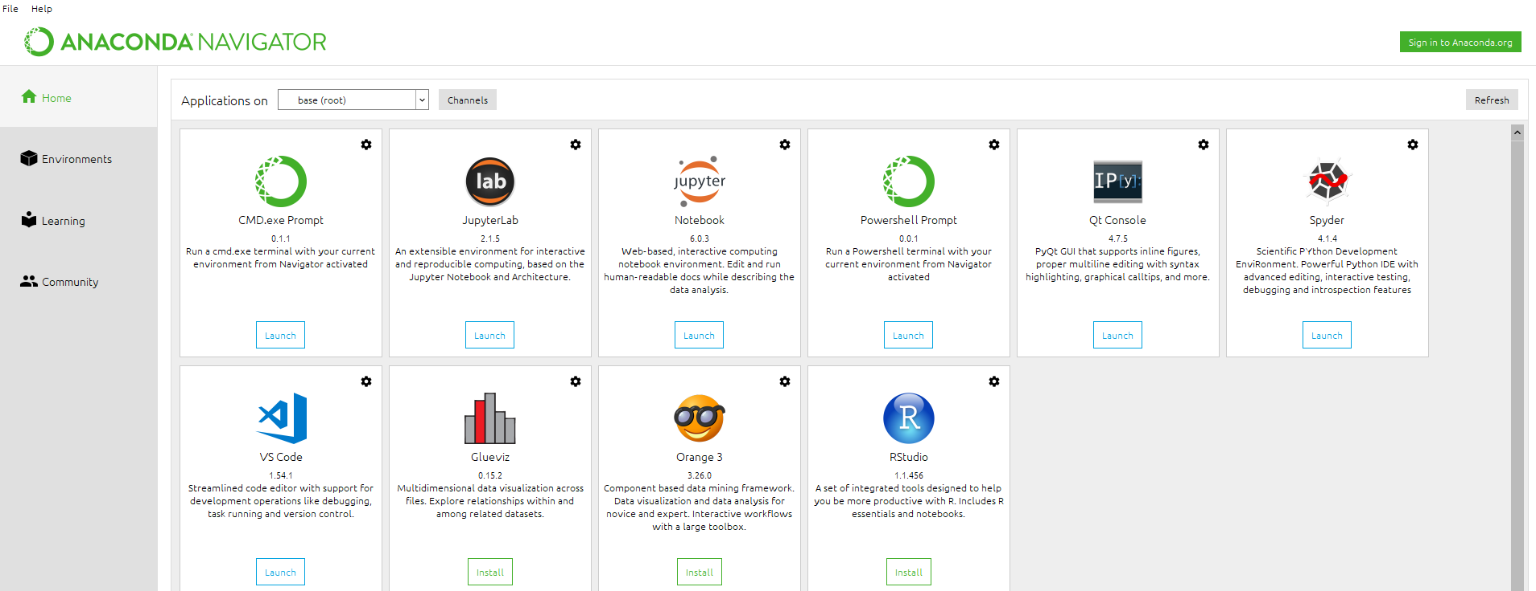
1.3 Install Jupyter Notebook via Anaconda
Anaconda
Anaconda is a free and open-source distribution of the Python programming languages for scientific computing that aims to simplify package management and deployment. Visit http://anaconda.com/downloads to download and install Anaconda
It provides different interface (Jupyter, Spyder) to execute python functions.
Python automatically comes with Anaconda; hence users only need to install Anaconda.
Python and pip (Python package manager) are included in Anaconda. After installation, the default python path is modified by Anaconda
Jupyter Notebook App
It is a server-client application that allows editing and running notebook documents via a web browser.
Spyder
Spyder is an open-source cross-platform integrated development environment (IDE) for scientific programming in the Python language.
© Jason Zhang. All Rights Reserved.

Slide 7
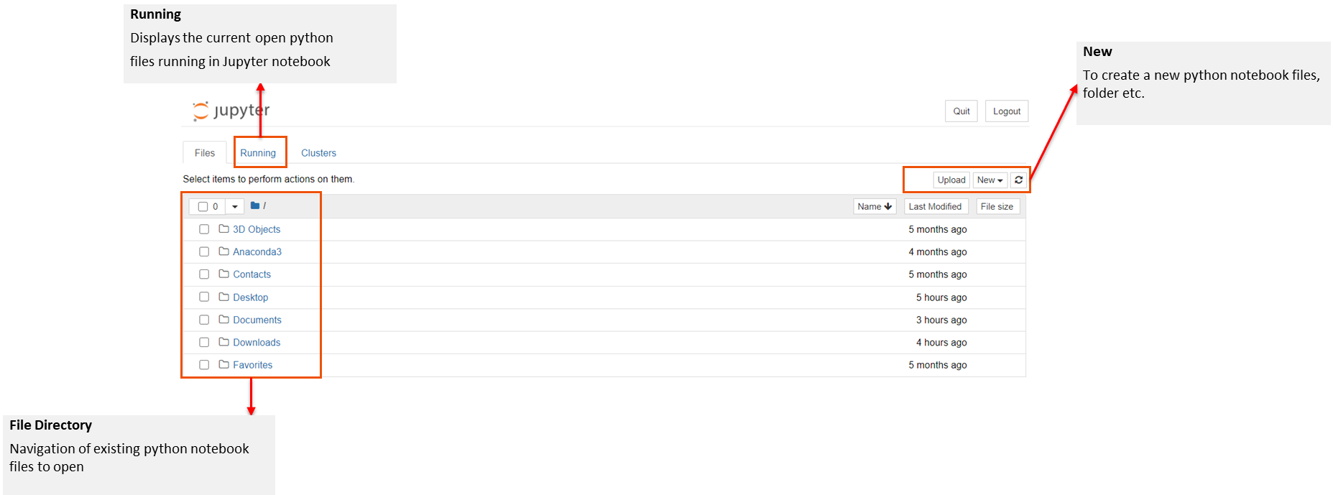
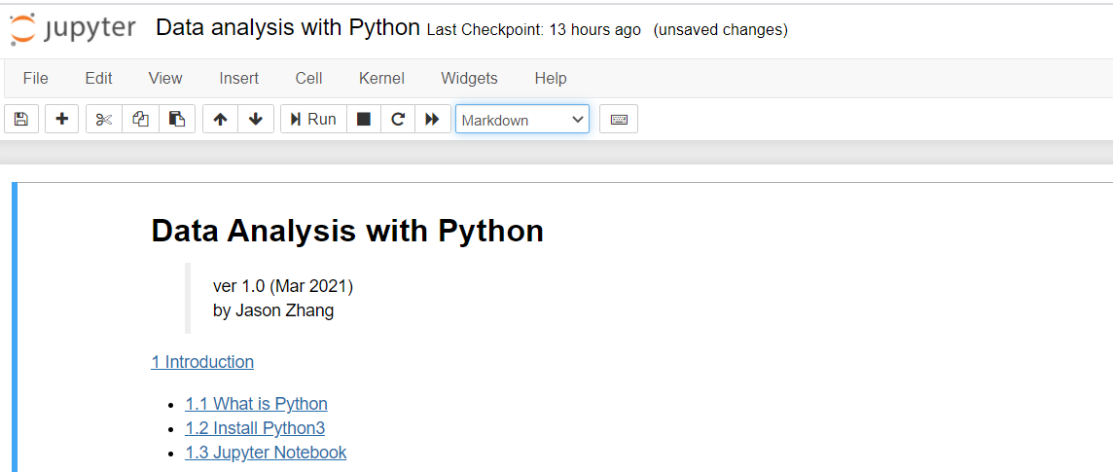
1.3 Jupyter Notebook Interface
Jupyter notebook opens to the default file directory (C: drive).
Open existing files by navigating to the appropriate directory or create a new python file using the “New” button in the top right corner.
Toolbar
Allows users to run, add another section of code, or change the code format.
Input/Output
User input of code or markdown and the result of output
© Jason Zhang. All Rights Reserved.
Notes:
Jupyter notebook, used a lot in data analysis. Our course will be mainly based on jupyter notebook.
Go to anaconda, and click the jupyter notebook
Data analysis with python jupyter notebook walk through

Slide 8

1.3 Jupyter Notebook Interface
Jupyter Notebook Shortcuts
Edit mode: text area is focused; left border is green.
Command mode: text area is out of focus, left border is blue.
Press Esc to exit Edit mode and enter Command mode . Use up/down arrow keys to select different lines.
Command Mode (press Esc to enable)
F: find and replace
Ctrl-Shift-F: open the command palette
Ctrl-Shift-P: open the command palette
Enter: enter edit mode
P: open the command palette
Shift-Enter: run cell, select below
Ctrl-Enter: run selected cells
Alt-Enter: run cell and insert below
Y: change cell to code
M: change cell to markdown
R: change cell to raw
1: change cell to heading 1
2: change cell to heading 2
3: change cell to heading 3
4: change cell to heading 4
5: change cell to heading 5
6: change cell to heading 6
K: select cell above
Up: select cell above
Down: select cell below
J: select cell below
Shift-K: extend selected cells above
Shift-Up: extend selected cells above
Shift-Down: extend selected cells below
Shift-J: extend selected cells below
A: insert cell above
B: insert cell below
X: cut selected cells
C: copy selected cells
Shift-V: paste cells above
V: paste cells below
Z: undo cell deletion
D,D: delete selected cells
Shift-M: merge selected cells, or current cell with cell below if only one cell is selected
Ctrl-S: Save and Checkpoint
S: Save and Checkpoint
L: toggle line numbers
O: toggle output of selected cells
Shift-O: toggle output scrolling of selected cells
H: show keyboard shortcuts
I,I: interrupt the kernel
0,0: restart the kernel (with dialog)
Esc: close the pager
Q: close the pager
Shift-L: toggles line numbers in all cells, and persist the setting
Shift-Space: scroll notebook up
Space: scroll notebook down
© Jason Zhang. All Rights Reserved.

Slide 9



2.1 Print
In Python3, `print` is a function.
A function can be invoked by specifying the function name, followed by arguments enclosed by a pair of parentheses.
We will look at more about functions later.
If no argument is given, `print` will output an empty line.
The print function outputs 2 parameters:
string "1 + 2 ="
the evaluated value of expression 1 + 2, which is 3
© Jason Zhang. All Rights Reserved.

Slide 10
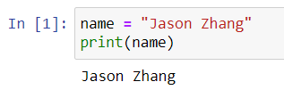
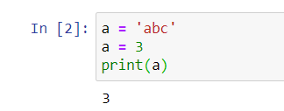
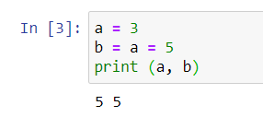
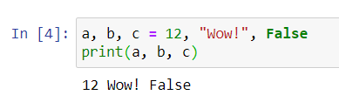
2.2 Variables
1. Definition
We will discuss what is variable. Variable is a core concept in programming. We use it variables to store data in computer memory.
We can imagine there is a lookup table in computer.
Variable is also called Identifier, which is a name referring to a value or values stored in the memory of the computer.
We can imagine there is a look-up table stored inside the computer, every time we define a variable, Python inserts one key-value pair into that table, where key is our variable name, and value is simply the value that the variable name referring to.
We created a variable called name and assigned the value "Jason Zhang" to it.
The first line of the program is called an assignment statement.
name ← “Jason Zhang”
2. Key – value
Illustrate the name, value, and assignment statement using equal signs.
= is not the same as ==
Variables' values can be changed (re-assigned).
Variable a is defined with an initial value 'abc’. Then a new value 3 is assigned to the variable a, thus the value of a is 3 at the final state.
Assignment statement is evaluated from right to left.
The expression on the right-hand-side of = is evaluated first, then assigned to the variable name on the left-hand-side of =.
3. Examples
You can assign values to multiple variables within one assignment statement
© Jason Zhang. All Rights Reserved.

Slide 11
2.2 Variables – code challenge
Q: Write a program to swap two variables.
© Jason Zhang. All Rights Reserved.

Slide 12
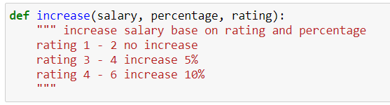
2.3 Comments
Annotates the code to help the programmer understands the intended logic.
These comments are ignored by the interpreter. A comment line starts with #.
Try to add some meaningful comments for reference, not only for you, but also someone who may read your code.
© Jason Zhang. All Rights Reserved.
Notes:
https://realpython.com/python-comments-guide/

Slide 13
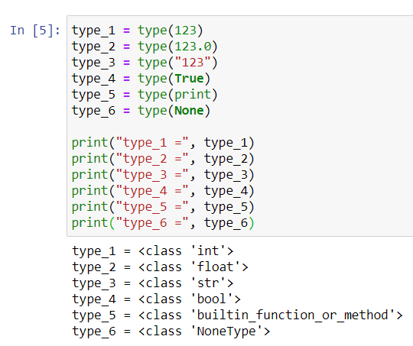
2.4 Data Types
Data Types | Description | Example
String (str) | A string form, usually printed with inverted commas, applicable to all words including numbers | “a”, “good”, “TRUE”, “23.4”, “2”
Integer (int) | A number that is usable with all aggregate and non- aggregated math functions | 1, 2, 3
Float (float) | Like numeric, except it has decimal place, i.e., not a whole number | 1.23, 3.5
Logical (bool) | A Boolean expression, defining true or false | True, False (Note: this is case-sensitive, hence it must be typed exactly as this example)
None (None) | None stands for an empty value | None
Use type() to get the data type of a specific value or a variable.
© Jason Zhang. All Rights Reserved.

Slide 14

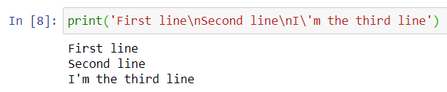
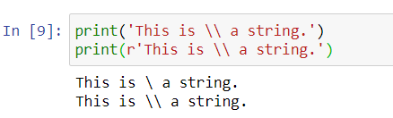
2.4 Data Types
Integers (int)
Python can deal with any integer values, including negative integers, such as 0, -99, 12345
Floating Point Number (float)
A floating-point number is a number that has a fractional part.
It is called floating point number because the position of the decimal point can be changed in the scientific notation.
For example, 3.1415e9 is the same as 314.15e7.
String (str)
A string is a text surrounded by a pair of single quotes ' or double quotes ", for example 'This is a string.', "This is another string.".
The first and last quotation marks should be matched, and they are not parts of the string.
Use escape character (\) to output new line \n, tab \t, back slash \\, single quote \', double quote \" etc. inside a string.
© Jason Zhang. All Rights Reserved.

Slide 15
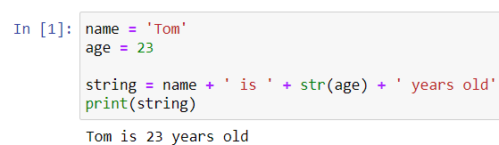
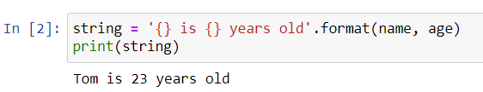

2.5 String Formatting
During programming, we are required to form strings containing variables frequently.
We can do this with concatenation using + operator.
Note:
A string cannot concatenate with a non-string data type; thus we must cast non-string values using str function.
We need to add leading or trailing spaces to some strings in order to make sure words are separated by spaces properly.
In Python, each string has a format function. format_string.format(arguments).
Note:
{} represents a variable in the format string.
We can re-arrange the order by specifying the index number in the braces, for example {2}.
We can apply padding, aligning and truncating to formatting numbers.
Note:
Use letter f represent floating point numbers.
We add a number after . to limit the number of digits after the decimal point
© Jason Zhang. All Rights Reserved.

Slide 16
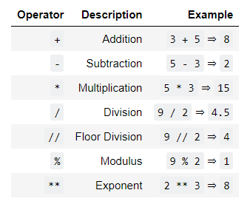
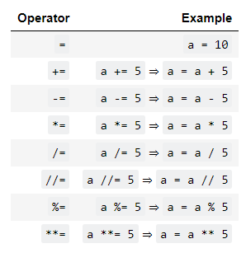
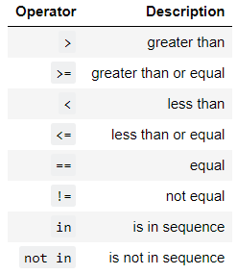
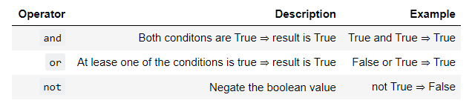
2.6 Operators
Basic Operators
Assignment Operators
Logical Operators
* A sequence can be a list, tuple etc.
Boolean Operators
© Jason Zhang. All Rights Reserved.

Slide 17
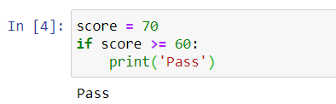
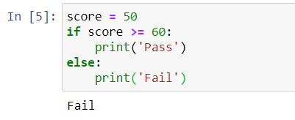
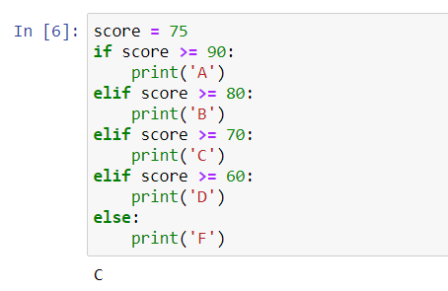
2.7 Control flow – if statement
if/elif/else Statement
condition
if condition is false
else code
if condition is true
If code
elif condition is true
elif code
Note:
Be careful to the indentation. Usually, we use 4-space or Tab indentation.
Don't miss the colon :
© Jason Zhang. All Rights Reserved.

Slide 18
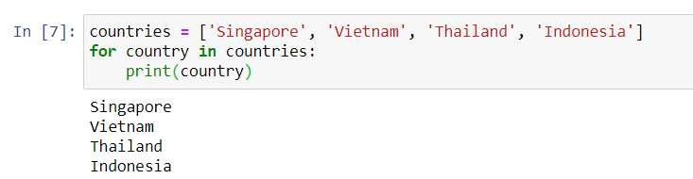
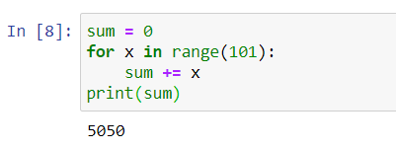
2.7 Control flow – for loop
for loop
all iterables are completed
Statement 1
Statement 2
etc …
iterables
continue to next iterable
© Jason Zhang. All Rights Reserved.

Slide 19
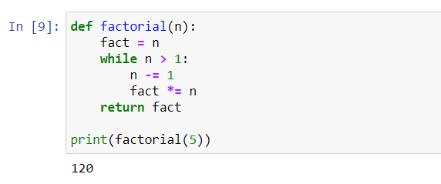
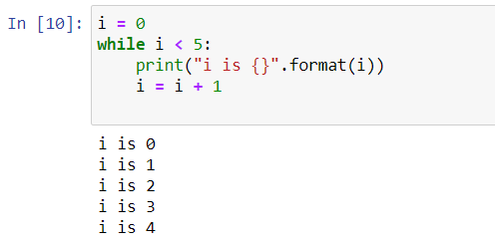
2.7 Control flow – while loop
while loop
False
Statement 1
Statement 2
Condition Update
condition
True
Note:
Be careful of infinite loops.
© Jason Zhang. All Rights Reserved.

Slide 20
2.7 Control flow – code challenge
Q: Write a program to get sum of all the odd numbers within 1000 using loops in three ways.
© Jason Zhang. All Rights Reserved.

Slide 21
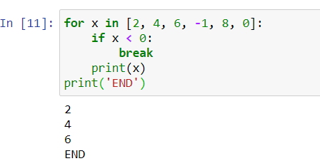
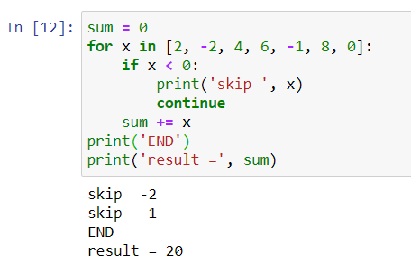
2.7 Control flow – break/continue
break
continue
use break statement to exit a loop.
use continue to skip current iteration and continue with the next one.
© Jason Zhang. All Rights Reserved.

Slide 22
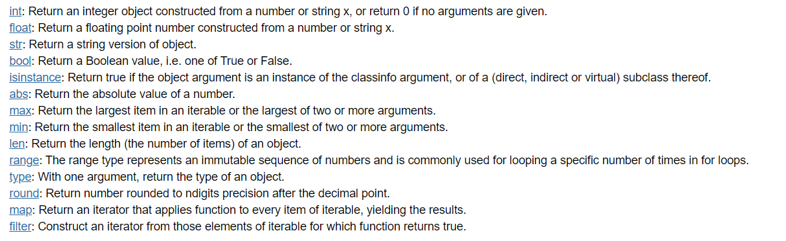





2.8 Built-in Functions
Some commonly used built-in functions
Type conversion
© Jason Zhang. All Rights Reserved.

Slide 23
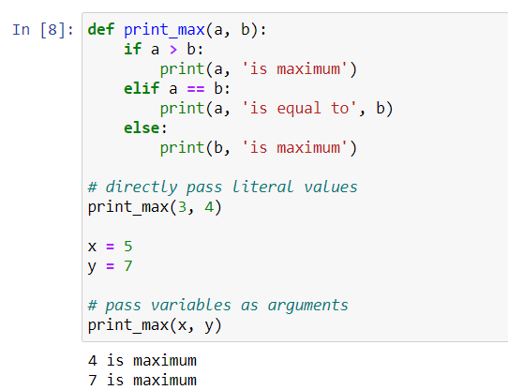
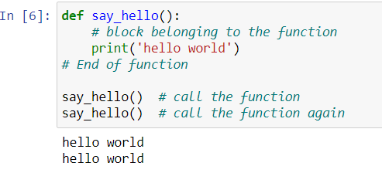
2.9 Functions
Functions are reusable pieces of programs.
A function can take parameters, which are values you supply to the function so that the function can do something utilising those values.
© Jason Zhang. All Rights Reserved.

Slide 24
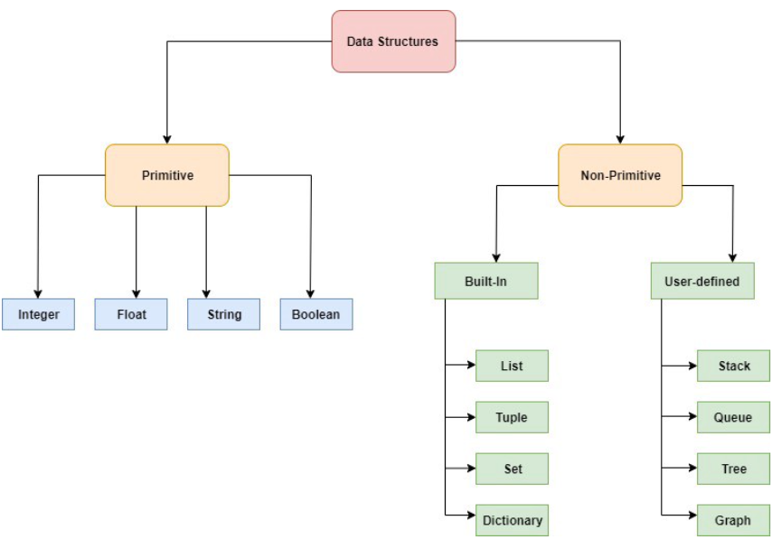
3.1 Data structure
Data structures provide us with a specific and way of storing and organizing data such that they can be easily accessed and worked with efficiently.
© Jason Zhang. All Rights Reserved.
Notes:
https://python.swaroopch.com/data_structures.html

Slide 25
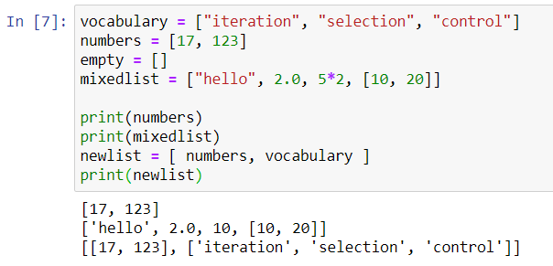

3.2 List
A list is a sequential collection of Python data values, where each value is identified by an index.
The values that make up a list are called its elements.
Lists are like strings, which are ordered collections of characters, except that the elements of a list can have any type and for any one list, the items can be of different types.
The variable vocabulary is a list.
You can get the number of items in it by using len()
© Jason Zhang. All Rights Reserved.

Slide 26
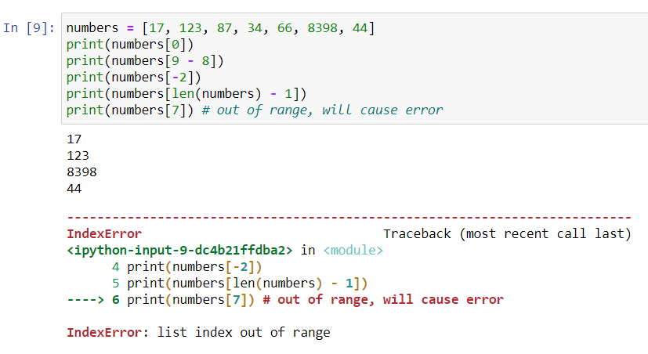

3.3 Access list element
A list index starts from zero.
We can get the index number of the last element in a list by calculating len(list) - 1. or
we can use -1 to get the last index directly
© Jason Zhang. All Rights Reserved.

Slide 27
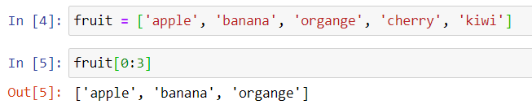
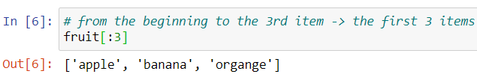

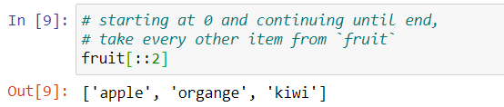
3.4 List slicing
It is a common operation to get a part of a list. For instance, to get the first 3 items in the following list.
Note:
fruit[0:3] means getting the items from index 0 to index 3, but 3 is not included. Thus, the result is equivalent to [ fruit[0], fruit[1], fruit[2] ]
Note:
We can omit the starting index if it is 0.
Note:
Since fruit[-2] represent the second last item, we can apply the same idea in slicing.
Note:
If the ending index is not included, slicing will get until the end of the list. Remember that -1 index represents the last item.
If there is a number after two colons :, it represents steps.
© Jason Zhang. All Rights Reserved.

Slide 28
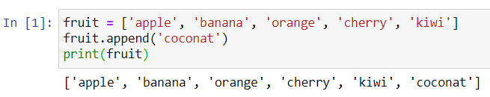
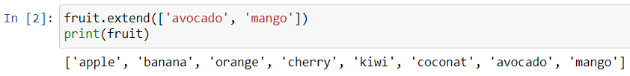
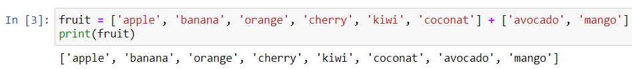
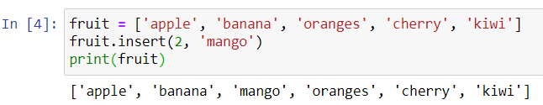
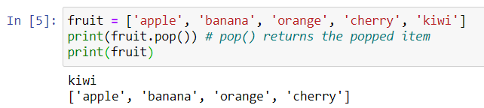
3.5 List method
list is a mutable sequence, which means you can add items to it, or remove items from it
append(): To add one more item to the end of the list
extend()
insert(): Insert an item to a specific position in the list
pop(): Remove the last item
© Jason Zhang. All Rights Reserved.
Notes:
https://docs.python.org/3/tutorial/datastructures.html

Slide 29
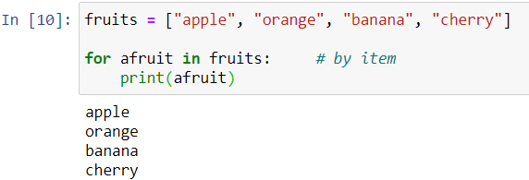
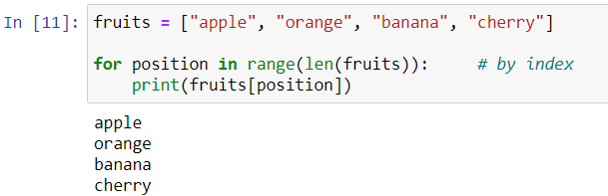
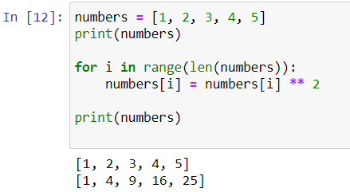
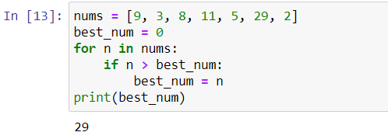
3.6 List & loops
Traverse the list using iteration by item
Traverse the list using iteration by index
Since lists are mutable, it is often desirable to traverse a list, modifying each of its elements as you go.
The following code squares the numbers from 1 to 5
The following code gets the maximum value from a list of integers.
© Jason Zhang. All Rights Reserved.
Notes:
https://docs.python.org/3/tutorial/datastructures.html

Slide 30
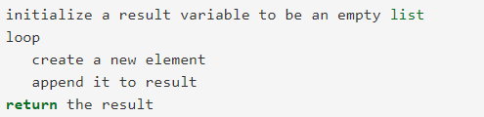
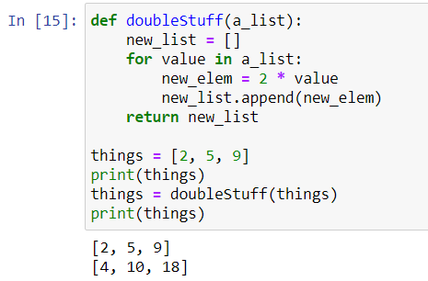
3.7 Generate a List
Whenever you need to write a function that creates and returns a list, the pattern is usually:
Initialize the result variable to be an empty list
Loop
Append it to the result
© Jason Zhang. All Rights Reserved.
Notes:
https://docs.python.org/3/tutorial/datastructures.html

Slide 31
3.8 Generate a List – Code challenge
Q: Write a program to generate the first 100 prime numbers. The input is the number of prime numbers, the output is a list of prime numbers.
© Jason Zhang. All Rights Reserved.
Notes:
https://docs.python.org/3/tutorial/datastructures.html

Slide 32




3.9 tuple
tuple is very similar to list except that tuple is immutable, which means you cannot modify a tuple.
Instead of using square brackets [] as in a list, we use parentheses () to represent tuples.
Once a tuple is initialized, elements cannot be changed, thus methods like append() or insert() are not applicable to tuples.
But you can do indexing, slicing on tuples just like lists.
Functions can return tuples as return values. This can be very useful.
We often want to know some batsman’s highest and lowest score, or we want to find the mean and the standard deviation, or we want to know the year, the month, and the day.
In each case, a function (which can only return a single value), can create a single tuple holding multiple elements.
© Jason Zhang. All Rights Reserved.

Slide 33



3.10 Dictionary
Dictionaries are Python’s built-in mapping type. A map is an unordered, associative collection. The association, or mapping, is from a key, which can be any immutable type, to a value, which can be any Python data object.
Dictionary is mutable.
The dictionary is denoted {key: value,…}. Empty dictionary can be denoted {}
It is efficient to look up values by keys.
Add new key-value pairs into a dict.
Assign value to an existing key replaces old one
© Jason Zhang. All Rights Reserved.

Slide 34




3.11 Dictionary method
keys(): Return the keys in the dict.
values(): Return the values in the dict.
items(): Returns a view of the key-value pairs as tuples in the dict.
get(): Return the value associated with key; None otherwise
© Jason Zhang. All Rights Reserved.

Slide 35
3.12 Dictionary – Code challenge
Q: Write a program called alice_words.py that creates a text file named alice_words.txt containing an alphabetical listing of all the words, and the number of times each occurs, in the text version of Alice’s Adventures in Wonderland. (You can obtain a free plain text version of the book, along with many others, from http://www.gutenberg.org.) The first 10 lines of your output file should look something like this
Word | Count
a | 631
a-piece | 1
abide | 1
able | 1
about | 94
above | 3
© Jason Zhang. All Rights Reserved.

Slide 36


3.13 Set
set is like a dict without values. Since keys are always unique, there is no duplicate in a set.
You can also construct a set by passing a list to the set() function.
© Jason Zhang. All Rights Reserved.

Slide 37




3.14 Set method
add(): Add an element to the set.
remove(): Remove a specified element.
difference(): Returns a set containing the difference between sets.
update(): updates the current set by adding items from another set.
© Jason Zhang. All Rights Reserved.

Slide 38

4.1 Python Package
It makes a Python program unmaintainable if there are too many variables and functions in a single file.
Through grouping functions into different modules, each file can have fewer codes.
In Python, each .py file can be regarded as a module
In order to prevent conflicts between modules, Python provides package to organize modules.
There are two modules, and both are called mod, but if they are in different packages, packageone and packagetwo, then it is totally fine.
They can be identified as packageone.mod and packagetwo.mod
© Jason Zhang. All Rights Reserved.
Notes:
https://docs.python.org/3/tutorial/modules.html

Slide 39





4.2 Install and Import from package
Install a package using pip
Import a package
Use the syntax “pip install <package>” in the command lines
Simply import it at the beginning of your codes
You can import a specific part of a module
Install a package in Jupyter
Use the syntax below in Jupyter notebook or command lines
You can import and assign alias for easier recall.
© Jason Zhang. All Rights Reserved.

Slide 40



4.3 Pandas overview
Pandas is an open-source Python library for performing highly specialized data analysis
It provides a single library for data analyst to easily process data, extract data and manipulate data.
Pandas provides two new data structures: Series and DataFrame.
The new data structures provide data manipulation capability equivalent to SQL-based relational database within Python
© Jason Zhang. All Rights Reserved.
Notes:
https://pandas.pydata.org/pandas-docs/stable/user_guide/10min.html

Slide 41



4.4 View data
We can get the dataframe top/bottom rows information using head(), tail().
We can view the data frame index and columns, data types, data shape in following methods
It is advisable to check these properties before you do the data analysis. It gives you ideas what kind of data frame you are dealing with.
© Jason Zhang. All Rights Reserved.

Slide 42

4.5 Slicing & Indexing
© Jason Zhang. All Rights Reserved.

Slide 43




4.5 Slicing & Indexing []
Indexing with [] is selecting out lower-dimensional slices.
© Jason Zhang. All Rights Reserved.

Slide 44




4.5 Slicing & Indexing loc
.loc is primarily label based.
© Jason Zhang. All Rights Reserved.

Slide 45



4.5 Slicing & Indexing iloc
.iloc is primarily integer position based
© Jason Zhang. All Rights Reserved.

Slide 46


4.5 Slicing & Indexing boolean vector
© Jason Zhang. All Rights Reserved.

Slide 47





4.6 Operations
© Jason Zhang. All Rights Reserved.

Slide 48








4.7 Merge Data
Join Types:
INNER: Returns records that have matching values in both tables
LEFT: Returns all records from the left table, and the matched records from the right table
RIGHT: Returns all records from the right table, and the matched records from the left table
OUTER: Returns all records when there is a match in either left or right table
© Jason Zhang. All Rights Reserved.

Slide 49



4.8 Concat Data
Note
It can be useful when we want to combine multiple files into one single file for our data analysis.
© Jason Zhang. All Rights Reserved.

Slide 50



4.9 Group Data
In data analysis, we often need to answer business questions by summarizing data. For example,
"What is the department sales in Q1?"
"How many new customers we have acquired in the past year?"
"Which product saw the biggest increase during the past 6 months?"
To answer these questions, we need to group the data by certain dimension(s) and calculate the metrics.
By “group by” we are referring to a process involving one or more of the following steps:
Splitting the data into groups based on some criteria
Applying a function to each group independently
Combining the results into a data structure
© Jason Zhang. All Rights Reserved.

Slide 51


4.10 Get Data In/Out
We can use pandas to read files to extract data. pandas supports a wide range of file format, such as csv, excel,json, HTML, SQL and so on.
Read csv
Write to csv
Read excel
Read files matching a pattern
© Jason Zhang. All Rights Reserved.

Slide 52



4.11 Handling Missing Values
Before you start cleaning a data set, it’s good to get a general feel for the data. What are the features?
What are the expected types (int, float, string, Boolean)?
Is there obvious missing data (values that Pandas can detect)?
Is there other types of missing data that’s not so obvious (can’t easily detect with Pandas)?
Sources of Missing Values, such as user forgot to fill in a field; there was a programming error etc.
1
Drop NA values
2
Impute values
© Jason Zhang. All Rights Reserved.

Slide 53

5.1 Numpy Introduction
Numpy is a library for the Python programming language, adding support for large, multi-dimensional arrays and matrices, along with a large collection of high-level mathematical functions to operate on these arrays.
NumPy provides a multi-dimensional array data structure, ndarray, which is a fast, flexible container for large data sets in Python.
In an ndarray, all the elements must be the same type.
Every ndarray has a shape, which is a tuple indicating the size of each dimension, and a dtype, describing the data type of the elements in the array.
© Jason Zhang. All Rights Reserved.
Notes:
https://numpy.org/doc/stable/user/quickstart.html

Slide 54





5.1 Array Creation
The most common way to create a ndarray is through a regular Python list or tuple using array function:
Be careful that the input argument is a list.
array transforms sequences of sequences into two-dimensional arrays, sequences of sequences of sequences into three-dimensional arrays, and so on.
NumPy offers several functions to create arrays with initial placeholder content.
The function zeros creates an array full of zeros.
The function ones creates an array full of one.
The function empty creates an array full of random float64 values.
© Jason Zhang. All Rights Reserved.
Notes:
https://numpy.org/doc/stable/user/quickstart.html

Slide 55



5.1 Array Creation
To create sequences of numbers, NumPy provides the arange function which is analogous to the Python built-in range, but returns an array.
It’s usually not possible to predict the number of elements obtained, due to the finite floating-point precision. For this reason, it is better to use the function linspace that receives as an argument the number of elements that we want.
linspace functions can be useful to evaluate function at lots of points
© Jason Zhang. All Rights Reserved.
Notes:
https://numpy.org/doc/stable/reference/generated/numpy.linspace.html

Slide 56



5.2 Array print
One-dimensional arrays are then printed as rows, bi-dimensionals as matrices and tri-dimensionals as lists of matrices.
The reshape function returns its argument with a modified shape.
© Jason Zhang. All Rights Reserved.

Slide 57







5.3 Array operations
Arithmetic operators on arrays apply elementwise. A new array is created and filled with the result.
The matrix product can be performed using the @ operator (in python >=3.5) or the dot function
© Jason Zhang. All Rights Reserved.

Slide 58






5.4 Array indexing & slicing
One-dimensional arrays can be indexed, sliced and iterated over, much like lists.
What’s the following slicing result on a 3*3 array?
© Jason Zhang. All Rights Reserved.

Slide 59



5.5 Array indexing tricks
In addition to indexing by integers and slices, arrays can be indexed by arrays of integers and arrays of Booleans.
Indexing with Arrays of Indices
The example converts an image of labels into a color image using a palette.
© Jason Zhang. All Rights Reserved.

Slide 60



5.5 Array indexing tricks
In addition to indexing by integers and slices, arrays can be indexed by arrays of integers and arrays of Booleans.
Indexing with Boolean Arrays
Indexing with Boolean array can be very useful in assignments
© Jason Zhang. All Rights Reserved.

Slide 61





5.6 Numpy methods
.random.random
return random floats in the half-open interval [0.0, 1.0).
.array_split
split an array into multiple sub-arrays.
.floor
return the floor of the input, element-wise.
.diag
extract a diagonal or construct a diagonal array.
.random.normal
returns random samples from a normal distribution.
© Jason Zhang. All Rights Reserved.

Slide 62






5.7 Numpy functions
Universal functions
A universal function, or ufunc is a function that performs elementwise operations on data in ndarray.
Unary ufuncs
Binary ufuncs
Mathematical and Statistical Methods
© Jason Zhang. All Rights Reserved.

Slide 63



5.8 Data processing using arrays
Where:
creates a new array of values base on another array.
any and all are two methods used in Boolean arrays.
any checks if one or more values in an array is True.
all checks if every value in an array is True.
sum is often used to count True values in a Boolean array.
© Jason Zhang. All Rights Reserved.
Notes:
http://web.mit.edu/~csvoss/Public/usabo/stats_handout.pdf
https://www.ic.unicamp.br/~wainer/cursos/1s2013/ml/livro.pdf

Slide 64
5.9 Numpy – Code challenge
Q: Write a program to solve sudoku.
We represent a sudoku in a 2-D array. The empty cell is filled with zero.
puzzle = [[5,3,0,0,7,0,0,0,0],
[6,0,0,1,9,5,0,0,0],
[0,9,8,0,0,0,0,6,0],
[8,0,0,0,6,0,0,0,3],
[4,0,0,8,0,3,0,0,1],
[7,0,0,0,2,0,0,0,6],
[0,6,0,0,0,0,2,8,0],
[0,0,0,4,1,9,0,0,5],
[0,0,0,0,8,0,0,7,9]]
© Jason Zhang. All Rights Reserved.

Slide 65


6.1 Functional Programming
Python's functional programming features make data processing more convenient.
Lambda function
A lambda function is a small anonymous function. A lambda function can take any number of arguments but can only have one expression.
Filter function
A filter function returns an iterator where the items are filtered through a function to test if the item is accepted or not.
© Jason Zhang. All Rights Reserved.
Notes:
https://realpython.com/python-lambda/

Slide 66


6.2 Functional Programming
Python's functional programming features make data processing more convenient.
Map function
A map function executes a specified function for each item in an iterable. The item is sent to the function as a parameter.
Reduce function
A reduce function is used to apply a particular function passed in its argument to all the list elements mentioned in the sequence passed along.
It is defined in functools module.
© Jason Zhang. All Rights Reserved.
Notes:
https://realpython.com/python-lambda/

Slide 67



6.3 Functional Programming
Map + Lambda to transform and generate a list
Map + Lambda is a convenient way to transform and generate a list.
The map() function runs a lambda function over the list [1, 2, 3, 4, 5], building a list-like collection of the results, like this:
© Jason Zhang. All Rights Reserved.
Notes:
https://realpython.com/python-lambda/

Slide 68

6.4 Functional Programming
Filter + Lambda to filter a list
Filter + Lambda is a convenient way to filter a list and return a subset of list where function returns true.
© Jason Zhang. All Rights Reserved.
Notes:
https://realpython.com/python-lambda/

Slide 69



7.1 Exception
Sometimes, running our syntactically correct code may cause errors, and we call it exceptions.
© Jason Zhang. All Rights Reserved.
Notes:
https://realpython.com/python-lambda/

Slide 70


7.2 Standard Exceptions
© Jason Zhang. All Rights Reserved.
Notes:
https://realpython.com/python-lambda/

Slide 71


7.3 Handling Exceptions
You can detect exceptions and handle them properly using try-except blocks.
Catch All Exceptions
Try clause between try and except is executed.
If no exception occurs, the except clause is skipped and excitation of the try statement is finished.
If an exception occurs during execution of the try clause, the rest of the clause is skipped. The except clause is executed and then the execution continues after the try statement.
Catch A Specific Exception
You can catch a specific type of exception and define a variable for it.
© Jason Zhang. All Rights Reserved.
Notes:
https://realpython.com/python-lambda/

Slide 72


7.3 Clean-up After Exceptions
The try statement has another optional clause which is intended to define clean-up actions that must be executed under all circumstances.
One place where you want to include exception handling is when you read or write to a file. Here is a typical example of file processing.
© Jason Zhang. All Rights Reserved.

Slide 73
7.4 Debugging
There are different kinds of errors can occur in program. It is useful if we can distinguish them:
Syntax error: It usually indicates something wrong with syntax of your code, such as
Omitting colon at the end of functions
Wrong indentation.
Strings should have matching quotation marks.
Unclosed bracket {, (, [
Sign = is not the same as ==
Runtime error: The program is syntactically correct, but it did not give what we expected, such as
Infinite loop
Infinite recursion
Exception handling, such as NameError, TypeError, KeyError, IndexError etc.
Semantic error: Semantic errors are hard to debug because compiler and runtime system provide no information
Break the program into smaller components and test each component independently.
Get some rest before you get frustrated.
© Jason Zhang. All Rights Reserved.

Slide 74




8.1 Working with Files
In real life data reside in files. File reading and writing are common input/output (IO) operations.
In Python, we must open files before we can use them and close them when we are done with them.
open(): create a file object
'folder/data.txt' is the path to the file we want to read
'r' stands for reading mode.
If the file does not exist, open() will throw an IOError exception.
read(): read from file object and get the content.
close(): close the file to release system resources
© Jason Zhang. All Rights Reserved.
Notes:
https://docs.python.org/3/library/functions.html#open

Slide 75

8.2 Locate Files on your disk
Files are located on disk by their path. You can think of path = directory + filename. For example,
In windows, the path might be C:\Users\yourname\My Documents\hello.txt
In Mac, the path might be /Users/yourname/hello.txt
A file hierarchy contains directories which contains files and other sub-directories.
myPythonProgram.py could access data files using the following relative file paths:
data1.txt
../myData/data2.txt
../myData/data3.txt
../../otherFiles/extraData/data4.txt
To specify a parent folder, we can use special .. notation.
It can be used multiple times to move multiple levels up a file hierarchy
If your file and your Python program are in different directories, then you must refer to one or more directories.
In a relative file path to the file like this: open('../myData/data3.txt', 'r'), or
In an absolute file path like open('/users/yourname/myFiles/allProjects/myData/data3.txt', 'r').
© Jason Zhang. All Rights Reserved.
Notes:
https://docs.python.org/3/library/functions.html#open

Slide 76


8.3 Read file content
We have a file called “graduate course type in Singapore.txt”.
We will read each line of the file and print it with some additional text.
Because text files are sequences of lines of text, we can use the for loop to iterate through each line of the file.
A line of a file is defined to be a sequence of characters up to and including a special character called the newline character represented as \n.
Delimiter character is used to separate fields in each line.
The common delimiters are comma, tab, and colon.
© Jason Zhang. All Rights Reserved.
Notes:
https://docs.python.org/3/library/functions.html#open

Slide 77

8.4 Read one line from file
Instead of reading the whole file content, we can read one line from the file.
Below table summarizes methods we can use.
When it reaches end of file, readline() and readlines() will return empty string.
Method Name | Use | Explanation
write | f.write(string) | Add string to the end of the file.
read(n) | f.read() | Reads and returns a string of n characters, or the entire file as a single string if n is not provided.
readline(n) | f.readline() | Returns the next line of the file with all text up to and including the newline character. If n is provided as a parameter than only n characters will be returned if the line is longer than n.
readlines(n) | f.readlines() | Returns a list of strings, each representing a single line of the file. If n is not provided, then all lines of the file are returned. If n is provided, then n characters are read but n is rounded up so that an entire line is returned.
Priming read
When reach end of file, it treats an empty string as False
This statement reassign variable to next line of the file.
© Jason Zhang. All Rights Reserved.
Notes:
https://docs.python.org/3/library/functions.html#open

Slide 78


8.5 Write to files
Writing files is like reading files, but we use 'w' or 'wb' mode to write text or binary files, respectively.
Remember to close the file, otherwise the last part of the data may be lost.
There is a with statement in Python which can help us close the opened files automatically:
© Jason Zhang. All Rights Reserved.
Notes:
https://docs.python.org/3/library/functions.html#open

Slide 79
8.6 File Input/Output – code challenge
Q: A sample file called studentdata.txt contains one line for each student in class.
Student name is the first thing on each line, followed by exam scores.
The number of scores might be different for each student.
Data file: studentdata.txt
aaron 10 15 20 30 40
bill 23 16 19 22
susan 8 22 17 14 32 17 24 21 2 9 11 17
jason 12 28 21 45 26 10
john 14 32 25 16 89
Write a program that prints out the names of students that have more than six quiz scores.
© Jason Zhang. All Rights Reserved.

Slide 80




8.7 Work with JSON file
JSON is one of the most popular formats for transferring data through APIs nowadays.
Python comes with a built-in module for encoding and decoding JSON data.
By passing the URL to requests.get function, we can get the response from the URL, which is usually HTML data.
We can convert JSON object (saved as a Python string) to a Python dictionary using json.loads.
Reversely, we can convert a Python dictionary to JSON format string using json.dumps
© Jason Zhang. All Rights Reserved.
Notes:
https://docs.python.org/3/library/functions.html#open

